Slide 1
ASP.NET MVC
Lesson 2 Entity Framework Core

Slide 2
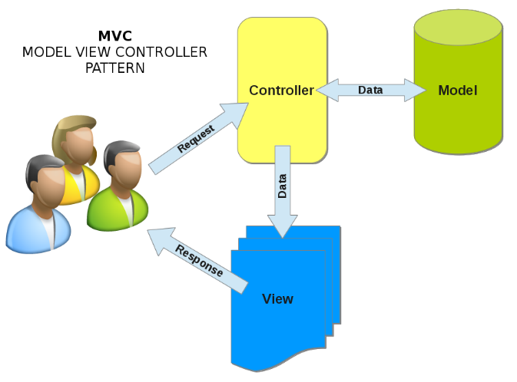
EF COre
Code First
Creating the Model Classes
Creating the DatabaseContext Class
Generating the Database Tables
Seeding the database
SQL Server Object Explorer

Slide 3
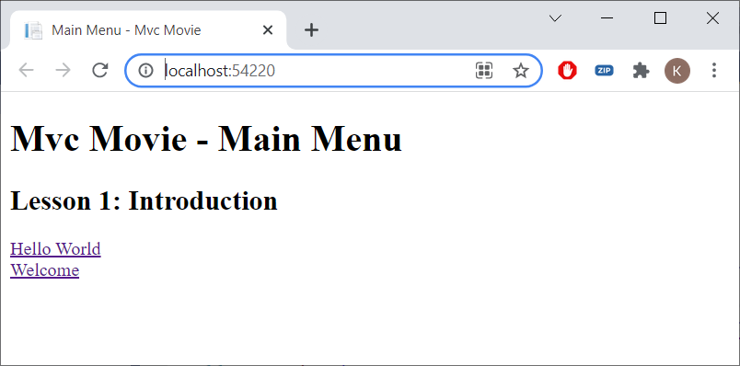
Open MvcMovie.sln
Ctrl-F5

Slide 4
Entity framework
Object/Relational Mapping (ORM) framework
RDBMS (SQL Server) ⬄ OO (C#)
SQL ⬄ No SQL (generated automatically)
Database tables ⬄ DBSets
Joins ⬄ Navigation properties
Publisher.Books[1].Author.Name
Publisher
Book
Author

Slide 5
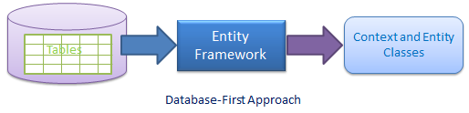
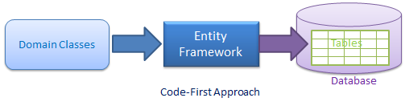
Entity Framework Core
EF Code First
The database is created from the models

Slide 6
Data Model
Movie
MovieID
Title
ReleaseDate
Genre
Price
RatingID
Navigation property
Rating
Rating
RatingID
Code
Name
Navigation property
Movies

Slide 7
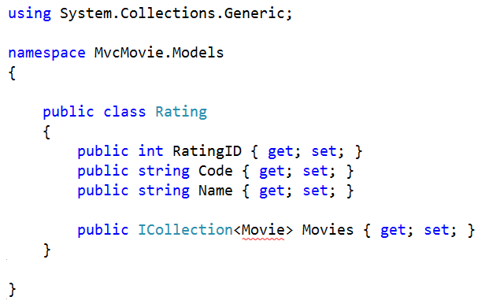
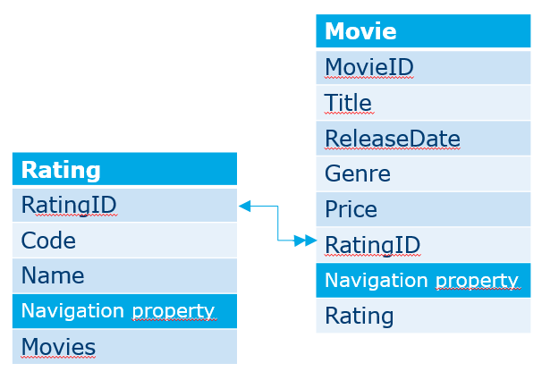
Creating the model
Models | Add New Item| Class | Rating.cs
Both RatingID and ID are recognized by EF as primary key
Movies is a navigation property (cfr. FK in Movie)

Slide 8
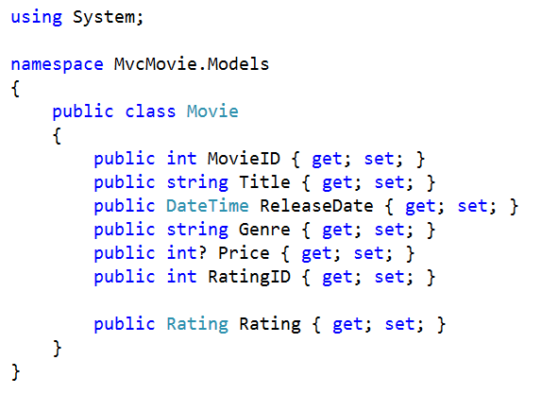
Movie.cs
? = nullable
Rating is a navigation property

Slide 9
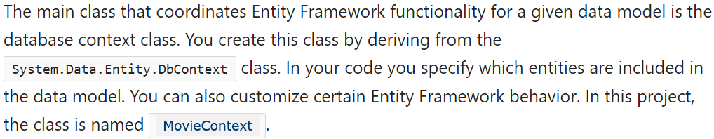
Database COntext
Data | Add | Class | MovieContext.cs
All communication/functionalities (create, read, update, delete) with the DB goes via the DBContext class

Slide 10
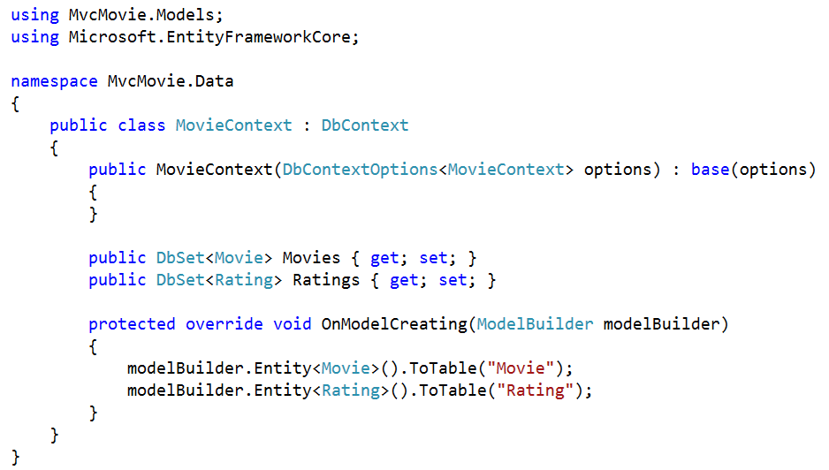
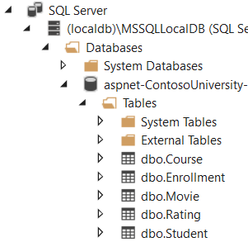
MovieContext.cs (resources or code-site)

Slide 11
Entity Framework
Database
MovieContext
Movies
Movie
Select … from Movie …
Application
Rating
Ratings
Insert into Movie …
Update Movie Set …
Delete from Movie…

Slide 12
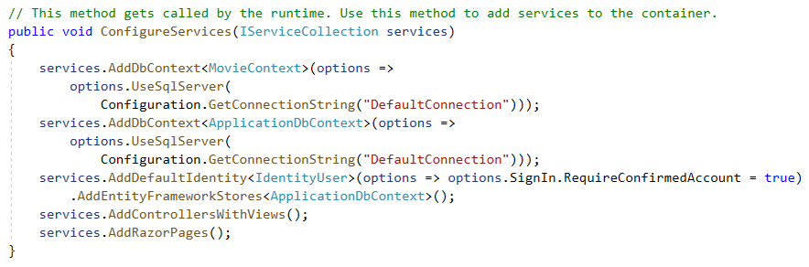
Startup.cs
Register MovieContext as a service

Slide 13
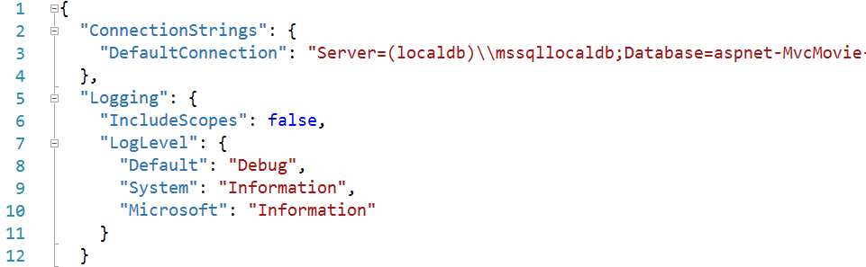
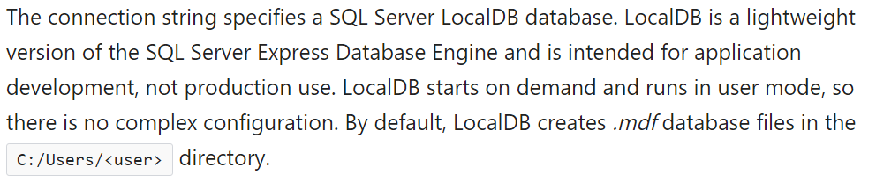
appsettings.json

Slide 14
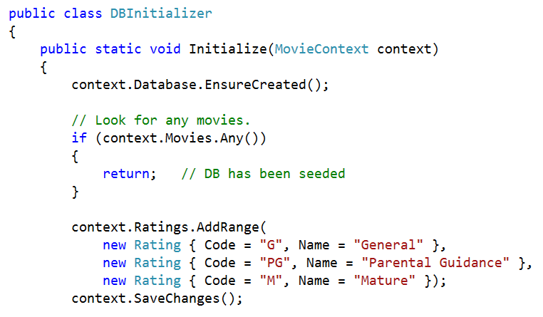
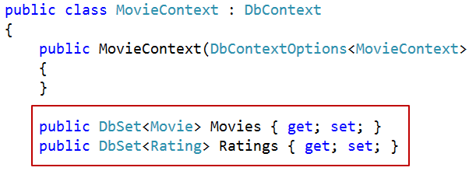
Test Data (resources)
Copy DbInitializer.cs to Data folder

Slide 15
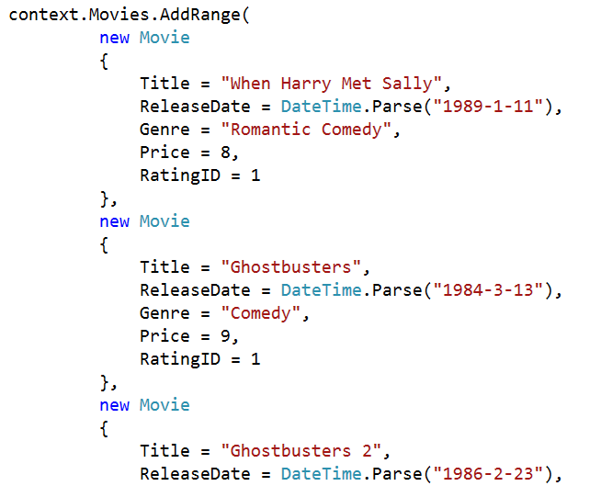
Test Data

Slide 16
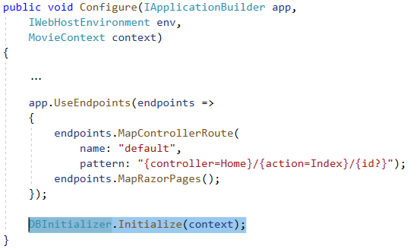
Startup.cs

Slide 17
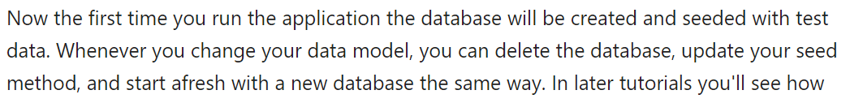
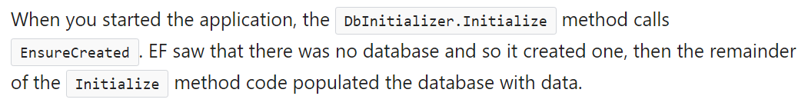
Run The Application (Ctrl-F5)

Slide 18
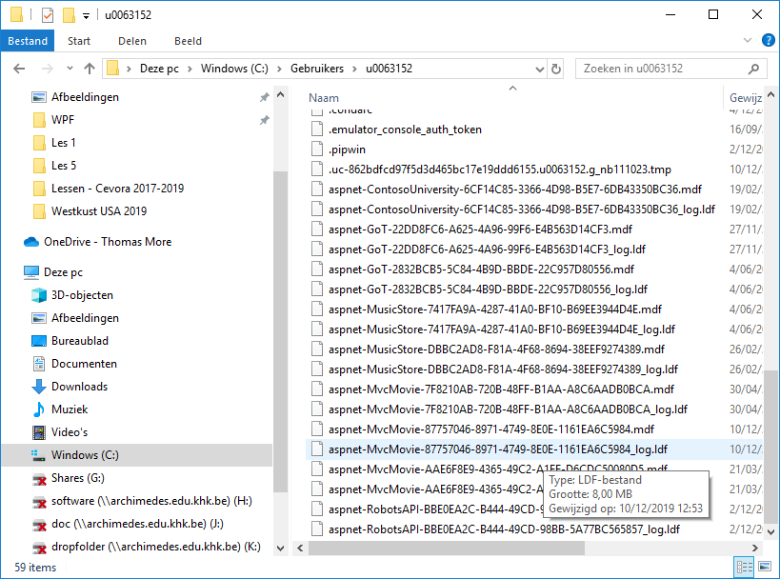
C:\users\xyz\aspnet-mvcmovie…mdf

Slide 19
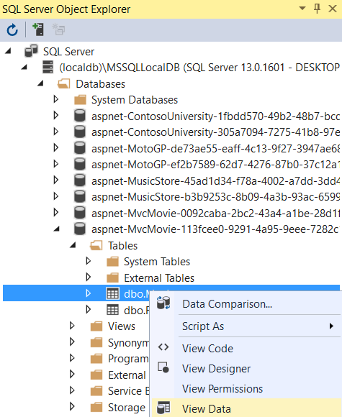
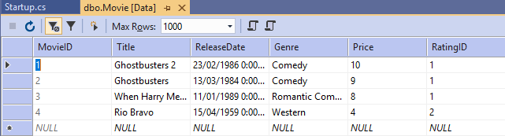
View | Sql Server Object Explorer

Slide 20
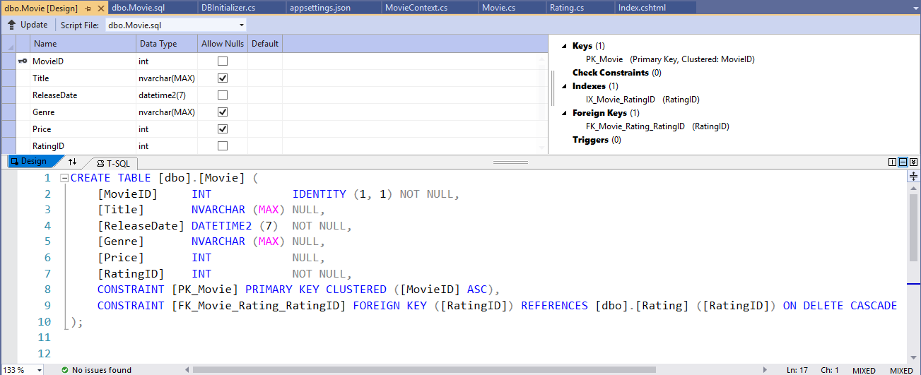
Sql Server Object Explorer
Movie | View Designer

Slide 21
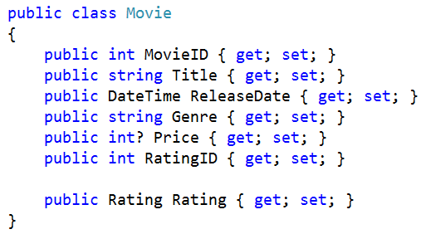
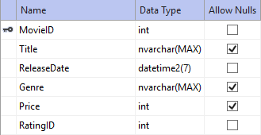
Allow Nulls
Genre and Title columns are also Nulls Allowed (default for string datatype)

Slide 22
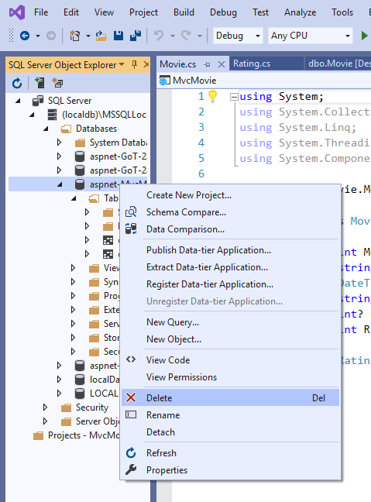
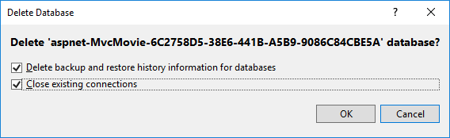
Delete the database
Better use Migrations (later in the course)

Slide 23
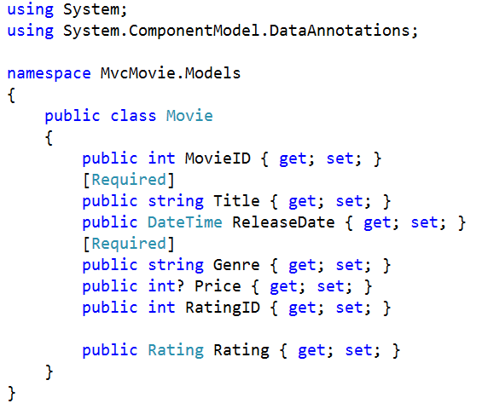
Required

Slide 24

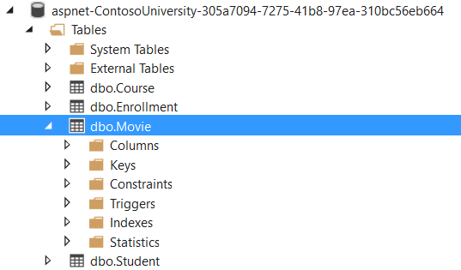
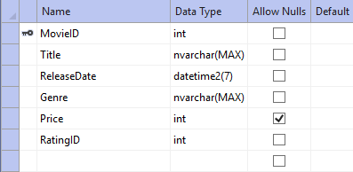
Run the Application

Slide 25
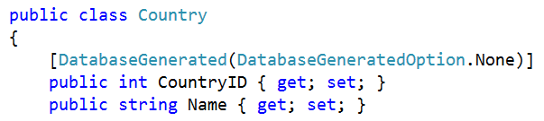
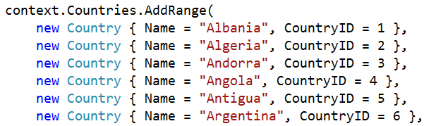
NO Auto Numbering (in Exercise)

Slide 26
Exercise
MotoGP Part 2

